Slide 1
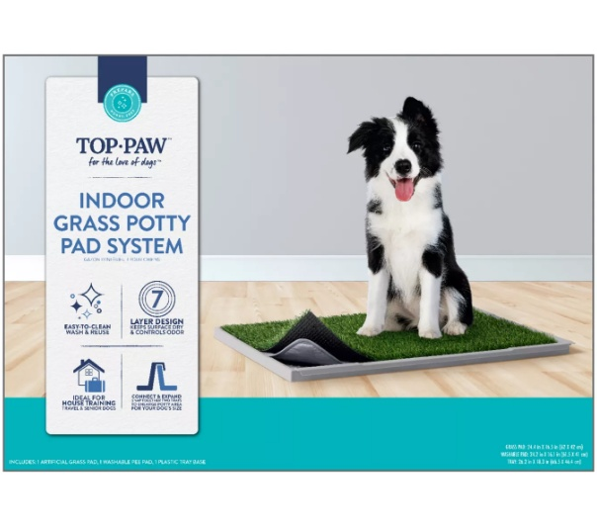
PEEPADS
Item Number
5360473
Color
Green, Gray
Retail
$34.99
Country
-
DESCRIPTION
Top Paw® Indoor Grass Potty Pad System For Dogs, Includes Grass Pad, Washable Pee Pad & Base Tray
MATERIAL
DIMENSIONS & SPECIFICATIONS
Artificial Grass, Plastic
Grass Pad: 24.4 in x 16.5 in (62 x 42 cm); Washable Pad: 24.2 x 16.1 in (61.5 x 41 cm); Tray: 26.2 in x 18.3 in (66.5 x 46.4 cm)

Slide 2
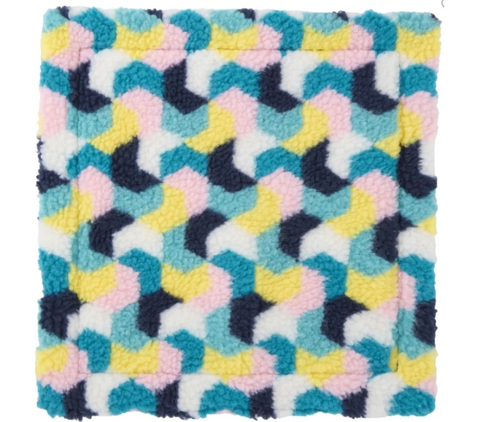
PEEPADS
Item Number
5353398
Color
Multiple Colors
Retail
$12.99
Country
-
DESCRIPTION
Full Cheeks™ Fleece Pee Pad
MATERIAL
DIMENSIONS & SPECIFICATIONS
Shell: 100% Polyester Filling: 100% Polyester Batting
12 in L x 12 in W x (30.4 x 30.4 cm)

Slide 3
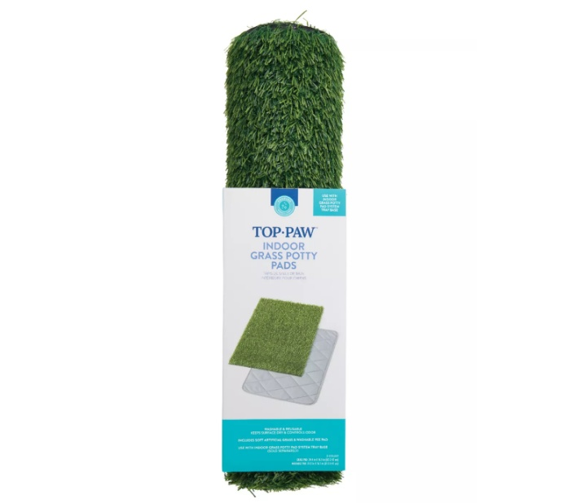
PEEPADS
Item Number
5360474
Color
Green, Gray
Retail
$29.99
Country
-
DESCRIPTION
Top Paw® Indoor Grass Potty Pads For Potty Training, Includes Artifical Grass Pad & Washable Pad
MATERIAL
DIMENSIONS & SPECIFICATIONS
Artificial Grass
Grass Pad: 24.4 in x 16.5 in (62 x 42 cm); Washable Pad: 24.2 in x 16.1 in (61.5 x 41 cm)

Slide 4
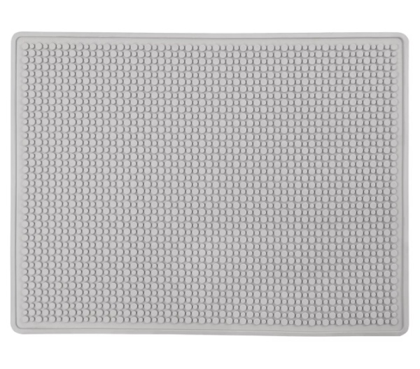
RUBBER MATS
Item Number
5297624
Color
Gray
Retail
$42.99
Country
China
DESCRIPTION
ExquisiCat® Cat Litter Trapping X-Large Mat, Waterproof, Urine-Proof, Gray, 37" x 28"
MATERIAL
DIMENSIONS & SPECIFICATIONS
Rubber
37 IN X 28 IN (93.9 X 71.1 cm)

Slide 5
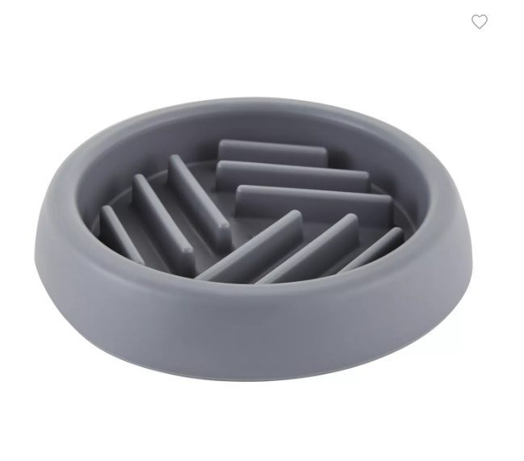
PET BOWLS
Item Number
5320471
Color
Grey
Retail
$10.99
Country
-
DESCRIPTION
Top Paw® Grey Puzzle Slow Feeder Dog Bowl, 0.75-cup
MATERIAL
DIMENSIONS & SPECIFICATIONS
Plastic
5.9 in DIA x 1 in H (14.9 x 2.54 cm)

Slide 6
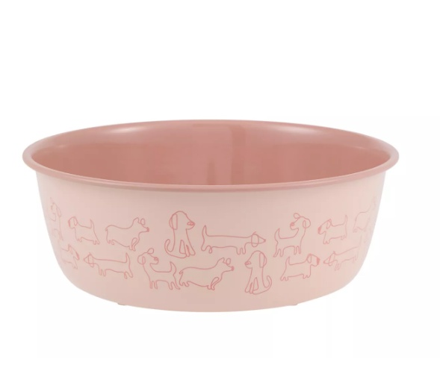
PET BOWLS
Item Number
5367107
Color
Pink
Retail
$12.99
Country
-
DESCRIPTION
Top Paw® Novelty Pink Dogs Stainless Steel Dog Bowl
MATERIAL
DIMENSIONS & SPECIFICATIONS
Plastic, Stainless Steel
8 IN X 8 IN X 3 IN (20.3 X 20.3 X 7.6 cm)

Slide 7
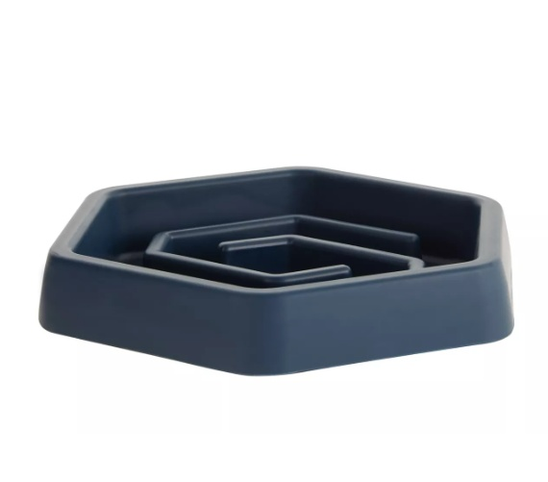
PET BOWLS
Item Number
5320473
Color
Blue
Retail
$14.99
Country
-
DESCRIPTION
Top Paw® Puzzle Slow Feeder Dog Bowl
MATERIAL
DIMENSIONS & SPECIFICATIONS
TPR
8.05 IN D X 9 IN W X 1.4 IN H(20.4 X 22.8 X 3.55 cm)

Slide 8
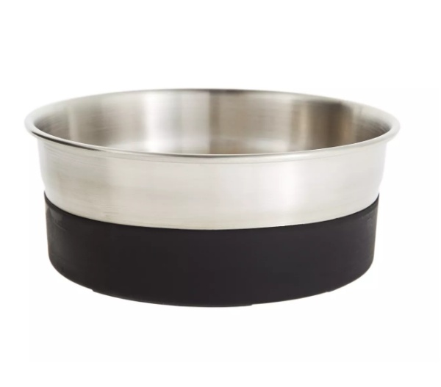
PET BOWLS
Item Number
5302639
Color
Black, Silver
Retail
$21.99
Country
-
DESCRIPTION
Top Paw® Stainless Steel Black Rubber Bottom Dog Bowl
MATERIAL
DIMENSIONS & SPECIFICATIONS
Metal, Plastic
7.75 in x 7.75 in x 3-1/8 in

Slide 9
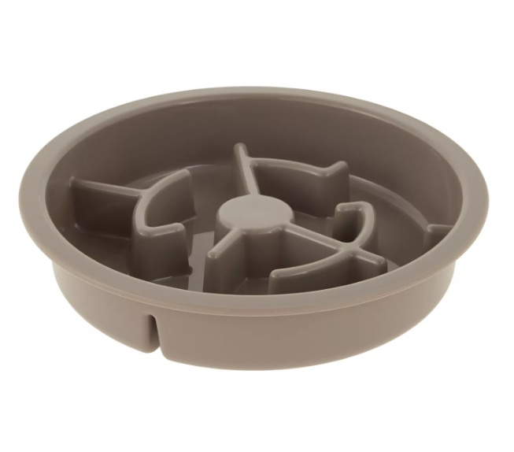
PET BOWLS
Item Number
5292121
Color
Grey
Retail
$18.99
Country
-
DESCRIPTION
Top Paw® Grey Slow Feeder Dog Bowl, 6.75-cup
MATERIAL
DIMENSIONS & SPECIFICATIONS
PP
10 IN DIA X 2 IN H (25.4 X 5.08 cm)

Slide 10
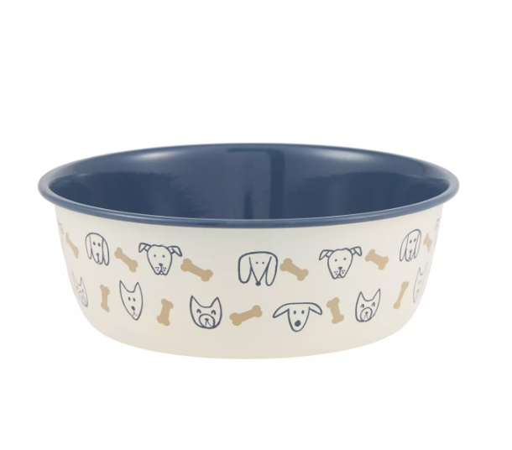
PET BOWLS
Item Number
5367106
Color
Cream, Blue, Brown
Retail
$12.99
Country
-
DESCRIPTION
Top Paw® Novelty Dog Faces Stainless Steel Dog Bowl
MATERIAL
DIMENSIONS & SPECIFICATIONS
Plastic, Stainless Steel
8 IN X 8 IN X 3 IN (20.3 X 20.3 X 7.26 cm)

Slide 11
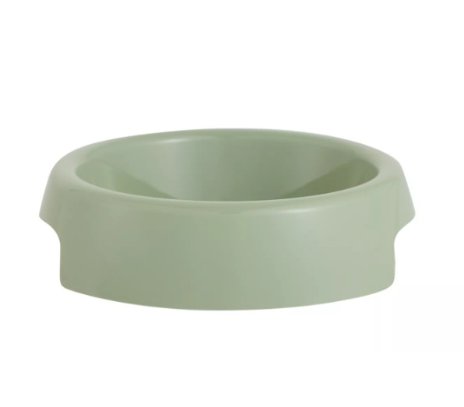
PET BOWLS
Item Number
5366815
Color
Green
Retail
$3.99
Country
-
DESCRIPTION
Top Paw® Green Plastic Dog Bowl
MATERIAL
DIMENSIONS & SPECIFICATIONS
Plastic
6.1 IN X 6.1 IN X 1.45 IN (15.4 X 15.4 X 3.68 cm)

Slide 12
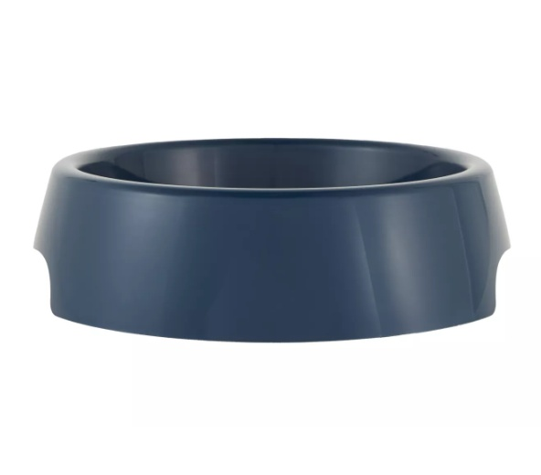
PET BOWLS
Item Number
5320478
Color
Blue Pearl
Retail
$5.99
Country
-
DESCRIPTION
Top Paw® Pearl Plastic Dog Bowl
MATERIAL
DIMENSIONS & SPECIFICATIONS
Plastic
8.2 IN X 10.5 IN X 2.8

Slide 13
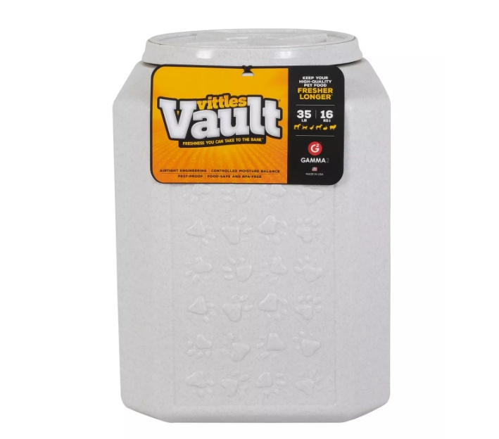
PET BOWLS
Item Number
5087369
Color
Granite Stone
Retail
$54.99
Country
-
DESCRIPTION
Vittles Vault® by GAMMA2 Paw Print Pet Food Container
MATERIAL
DIMENSIONS & SPECIFICATIONS
BPA-Free HDPE Plastic
12 in x 12 in x 16.75 in

Slide 14
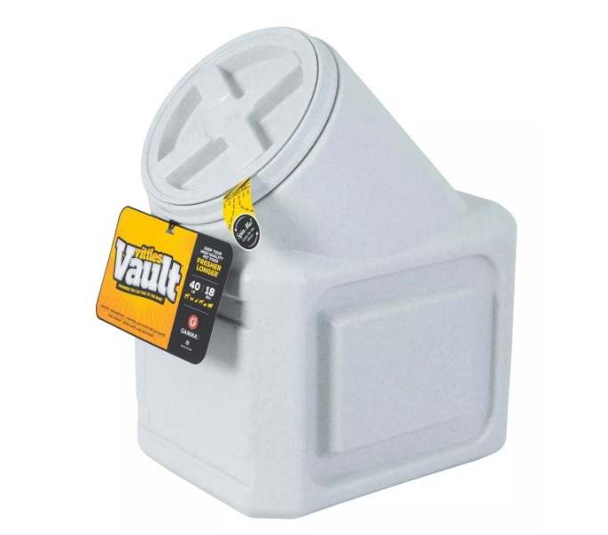
PET BOWLS
Item Number
5063535
Color
Granite Stone
Retail
$64.99
Country
-
DESCRIPTION
Vittles Vault® by GAMMA2 Stackable Pet Food Container
MATERIAL
DIMENSIONS & SPECIFICATIONS
BPA-Free HDPE Plastic
12 in x 20.5 in x 16.75 in

Slide 15
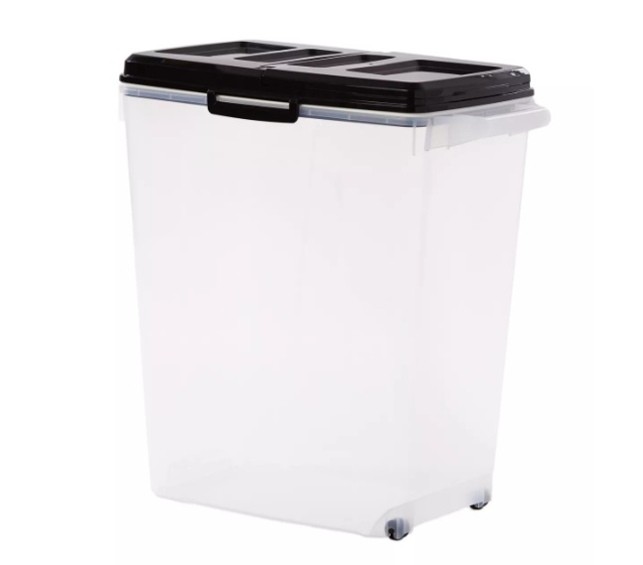
PET BOWLS
Item Number
5302226
Color
Clear, Black
Retail
$44.99
Country
-
DESCRIPTION
Top Paw® Plastic Food Storage Container with Dual-Sided Lid and Built-In Scoop, BPA-Free
MATERIAL
DIMENSIONS & SPECIFICATIONS
Plastic
21 .5 in

Slide 16
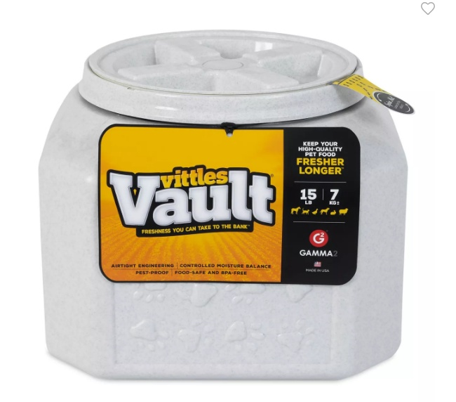
PET BOWLS
Item Number
5094489
Color
Granite Stone
Retail
$49.99
Country
-
DESCRIPTION
Vittles Vault® by GAMMA2 Pet Food Container, 15 LB
MATERIAL
DIMENSIONS & SPECIFICATIONS
BPA-Free HDPE Plastic
12 in x 12 in x 8.75 in

Slide 17
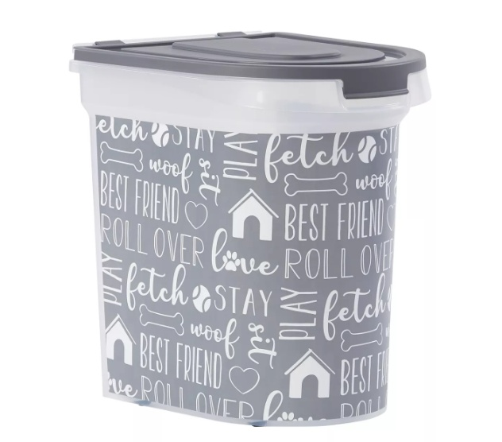
PET BOWLS
Item Number
5311608
Color
Clear, Black
Retail
$39.99
Country
-
DESCRIPTION
Paw Prints Printed Pet Food Storage Container with Wheels, 26-lb
MATERIAL
DIMENSIONS & SPECIFICATIONS
Plastic
-

Slide 18
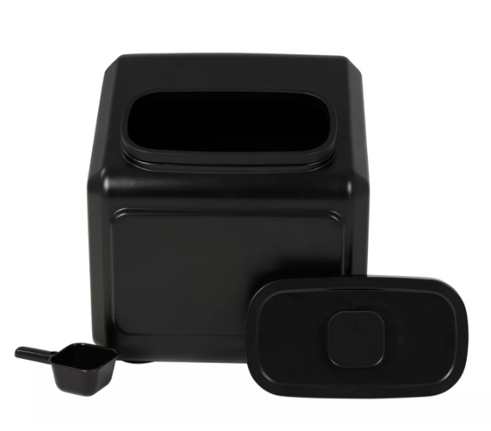
PET BOWLS
Item Number
5366617
Color
Black
Retail
$64.99
Country
-
DESCRIPTION
Top Paw® Airtight Dog Food Storage Container
MATERIAL
DIMENSIONS & SPECIFICATIONS
PP, HDPE, ABS, Silicone
17.9 IN W X 17.9 IN L X 15.7 IN H (45.4 X 45.4 X 40 cm)

Slide 19
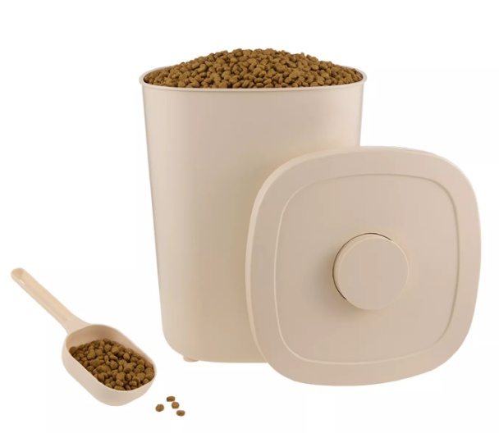
PET BOWLS
Item Number
5366807
Color
Cream
Retail
$34.99
Country
-
DESCRIPTION
Whisker City® Food Storage Container & Scoop
MATERIAL
DIMENSIONS & SPECIFICATIONS
Plastic
9.84 IN W X 9.84 IN D X 12.91 IN H

Slide 20
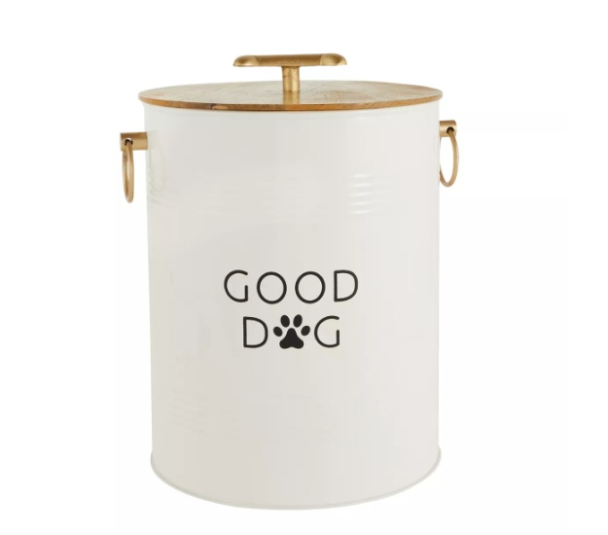
PET BOWLS
Item Number
5357766
Color
White, Black, Brown
Retail
$49.99
Country
-
DESCRIPTION
Top Paw® Storage Tin
MATERIAL
DIMENSIONS & SPECIFICATIONS
Tin, Wood
11.25 in x 11.25 in x 15.5 in

Slide 21
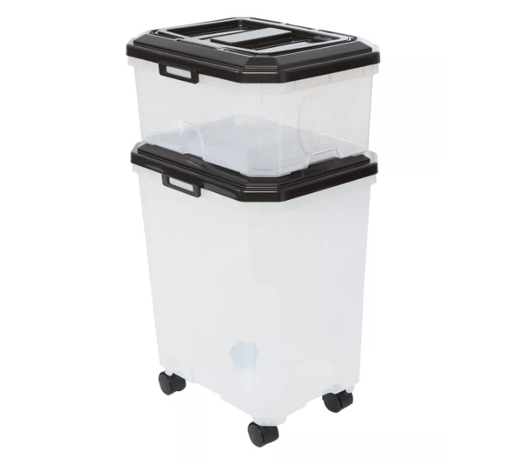
PET BOWLS
Item Number
5325891
Color
Clear, Black
Retail
$39.99
Country
-
DESCRIPTION
Top Paw® Stackable Storage Containers - 2 Containers & 2 Scoops
MATERIAL
DIMENSIONS & SPECIFICATIONS
Plastic
31 in L & 11.3 in L

Slide 22
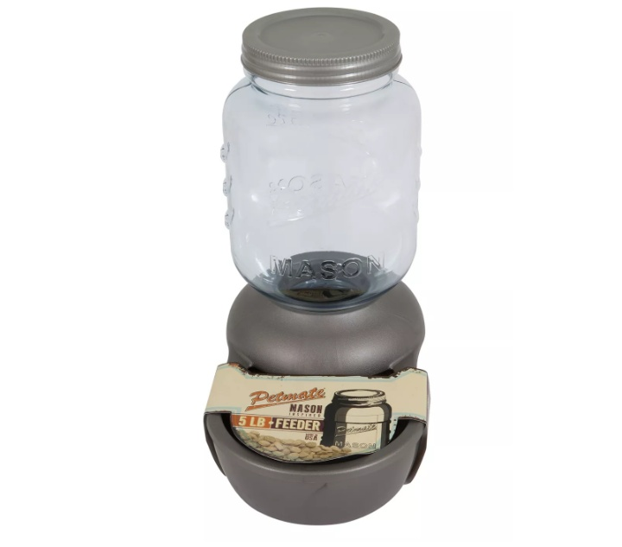
PET BOWLS
Item Number
5214246
Color
Silver
Retail
$62.99
Country
-
DESCRIPTION
Petmate® Mason Jar Replenishing Pet Waterer
MATERIAL
DIMENSIONS & SPECIFICATIONS
BPA Free Plastic
17.24 x 10.28 x 17.73

Slide 23
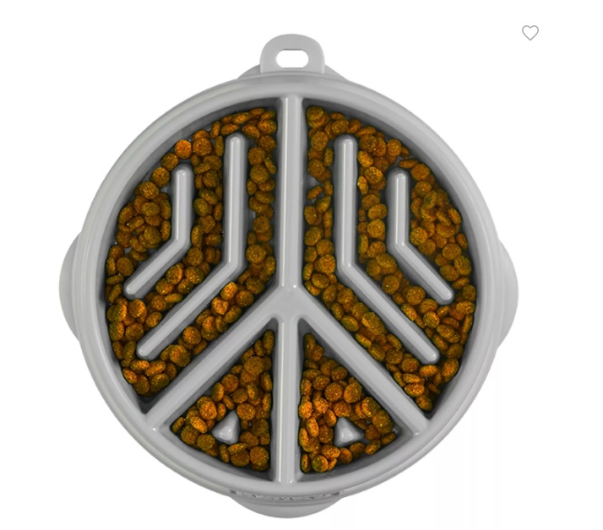
PET BOWLS
Item Number
5366805
Color
Green
Retail
$15.99
Country
-
DESCRIPTION
Outward Hound Fun Feeder Slow Bowl Peace
MATERIAL
DIMENSIONS & SPECIFICATIONS
-
9.09 x 8.66 x 1.42

Slide 24
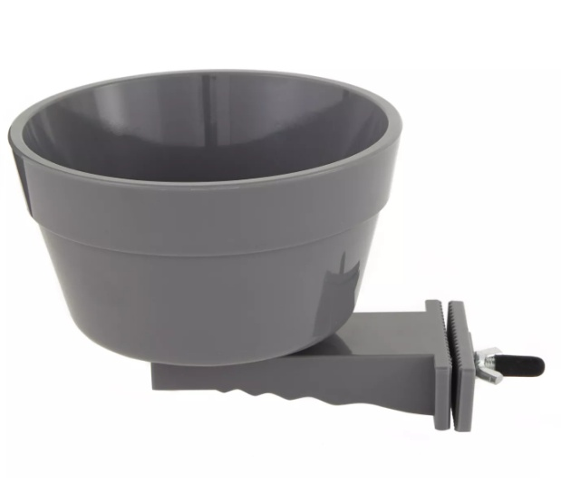
PET BOWLS
Item Number
5357767
Color
Grey
Retail
$16.99
Country
-
DESCRIPTION
Top Paw® Crate Crock
MATERIAL
DIMENSIONS & SPECIFICATIONS
Plastic
5.4 X 6.1 X 5.3

Slide 25
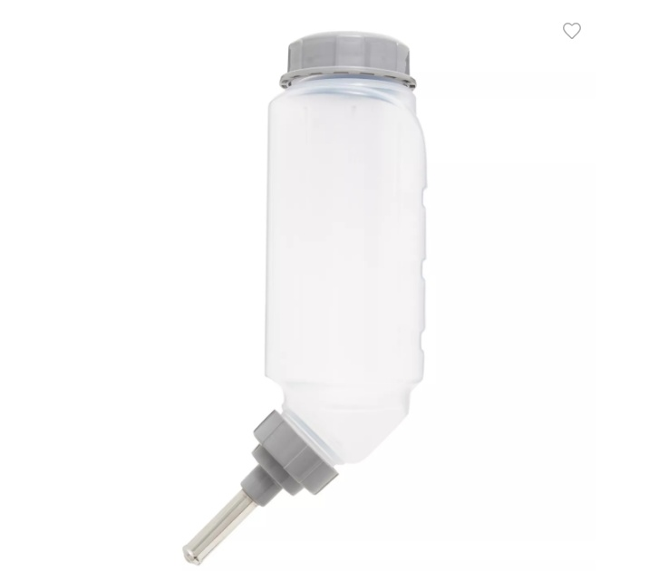
PET BOWLS
Item Number
5343219
Color
Grey, Clear
Retail
$19.99
Country
-
DESCRIPTION
Top Paw® No-Drip Water Bottle
MATERIAL
DIMENSIONS & SPECIFICATIONS
Plastic, Stainless Steel
-

Slide 26
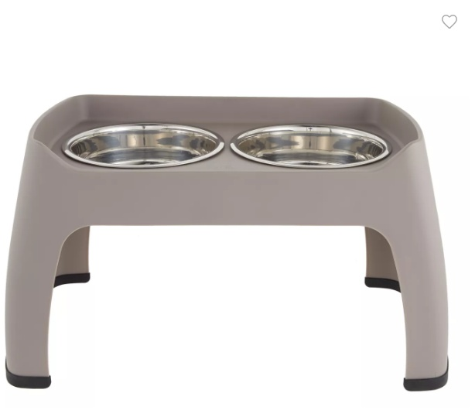
PET BOWLS
Item Number
5292196
Color
Grey
Retail
$59.99
Country
-
DESCRIPTION
Top Paw® Elevated Double Diner Pet Feeder
MATERIAL
DIMENSIONS & SPECIFICATIONS
-
15 in (38.1 cm)

Slide 27
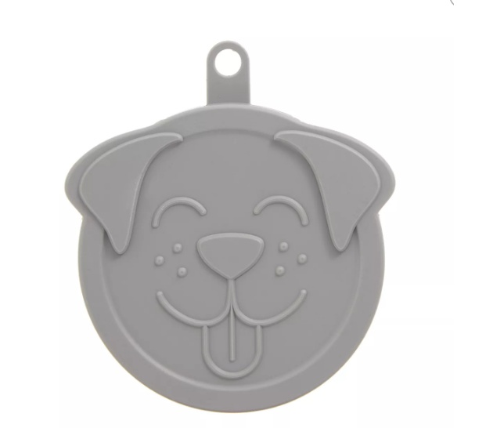
PET BOWLS
Item Number
5320964
Color
Assorted colors
Retail
$3.99
Country
-
DESCRIPTION
Top Paw® Dog Face Pet Food Can Cover (COLOR VARIES)
MATERIAL
DIMENSIONS & SPECIFICATIONS
Plastic
-

Slide 28
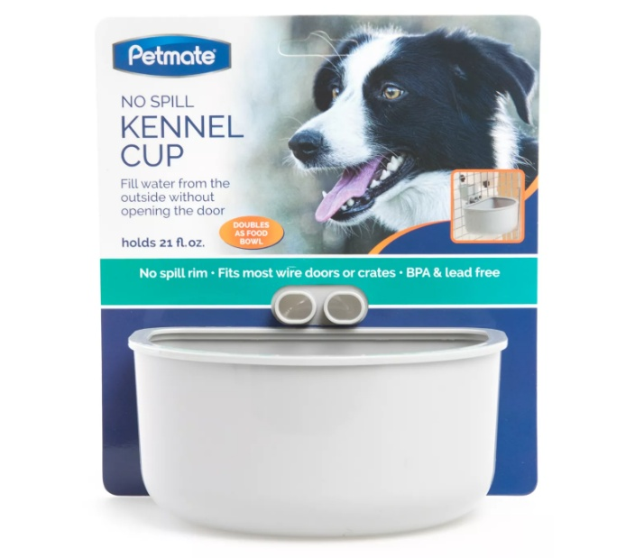
PET BOWLS
Item Number
5270308
Color
Grey
Retail
$11.99
Country
-
DESCRIPTION
Petmate® No Spill Kennel Cup
MATERIAL
DIMENSIONS & SPECIFICATIONS
Plastic
-

Slide 29
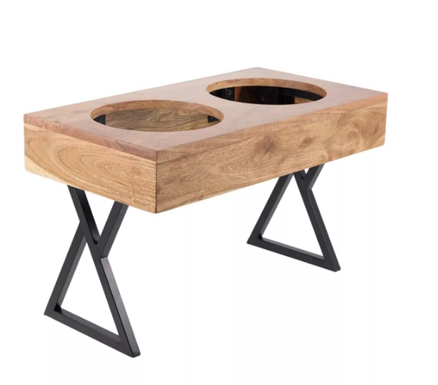
PET BOWLS
Item Number
5367329
Color
Brown
Retail
$64.99
Country
-
DESCRIPTION
Top Paw® Adjustable BPA Free Double Diner with 2 Bowls
MATERIAL
DIMENSIONS & SPECIFICATIONS
Wood, Stainless Steel
Each Overall Height: 3.2 IN, 8.6 IN, 12.5 IN (8.2 cm, 21.8 cm, 31.7 cm)

Slide 30
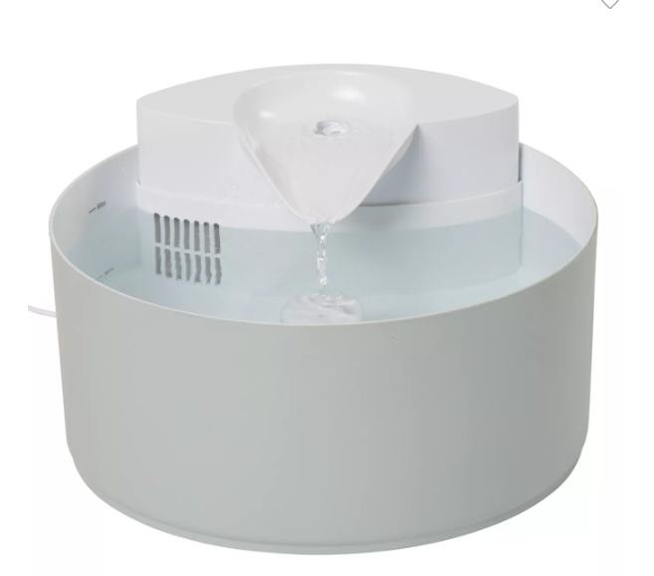
PET BOWLS
Item Number
5366865
Color
White
Retail
$79.99
Country
-
DESCRIPTION
Top Paw® Flowing Fountain
MATERIAL
DIMENSIONS & SPECIFICATIONS
Plastic
-

Slide 31
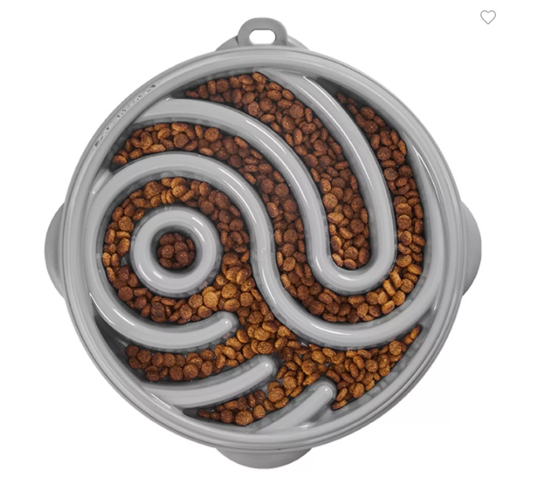
PET BOWLS
Item Number
5366644
Color
Pink
Retail
$21.99
Country
-
DESCRIPTION
Outward Hound Ying Yang Slow Feeder
MATERIAL
DIMENSIONS & SPECIFICATIONS
-
Bowl: 10.75 x 10.51 x 1.79

Slide 32
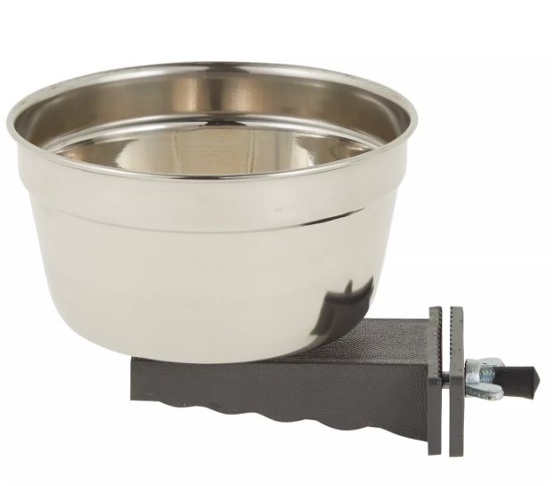
PET BOWLS
Item Number
5357765
Color
Silver, Gray
Retail
$19.99
Country
-
DESCRIPTION
Top Paw® Crate Crock
MATERIAL
DIMENSIONS & SPECIFICATIONS
Stainless Steel, Plastic
4⅞ in x 4⅞ in x 3⅝ in

Slide 33
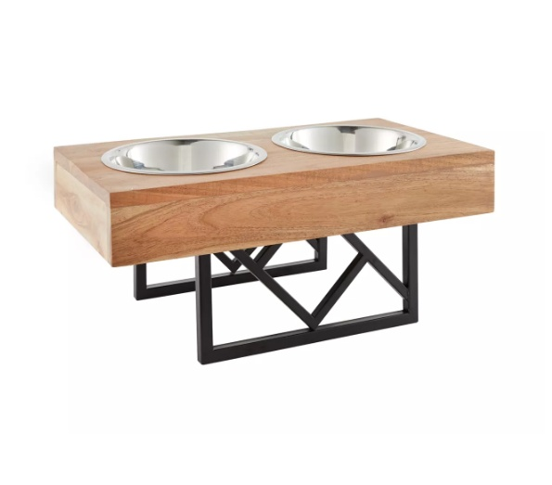
PET BOWLS
Item Number
5347802
Color
Color of diner may vary
Retail
$59.99
Country
-
DESCRIPTION
Top Paw® Adjustable Double Diner
MATERIAL
DIMENSIONS & SPECIFICATIONS
Wood, Steel
Overall Height: 3.2 in, 8.6 in, 12.5 in (8.2 cm, 21.8 cm, 31.7 cm)

Slide 34
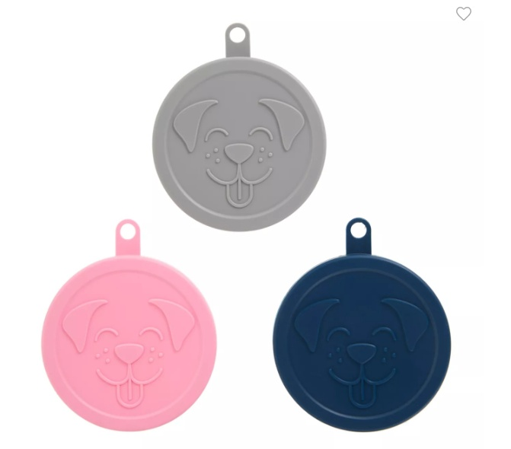
PET BOWLS
Item Number
5320963
Color
Grey, Pink, & Blue
Retail
$8.99
Country
-
DESCRIPTION
Top Paw® Dog Face Pet Food Can Covers - 3 Pack
MATERIAL
DIMENSIONS & SPECIFICATIONS
Plastic
-

Slide 35
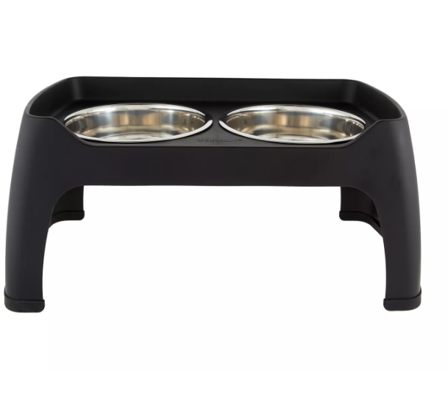
PET BOWLS
Item Number
5309259
Color
Black
Retail
$49.99
Country
-
DESCRIPTION
Top Paw® Elevated Double Diner Pet Feeder
MATERIAL
DIMENSIONS & SPECIFICATIONS
Plastic, Stainless Steel
Overall Height: 12 in (30.4 cm)

Slide 36
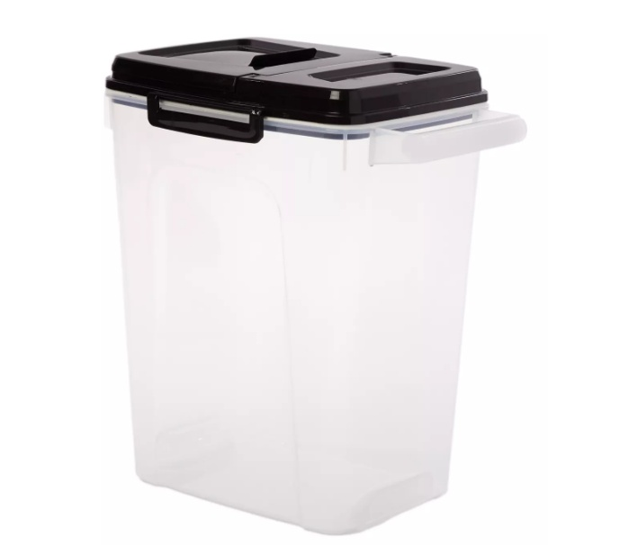
PET BOWLS
Item Number
5302225
Color
Clear, Black
Retail
$25.99
Country
-
DESCRIPTION
Top Paw® Plastic Food Storage Dispenser with Pour Spout, BPA-Free
MATERIAL
DIMENSIONS & SPECIFICATIONS
Plastic
21 .5 in

Slide 37
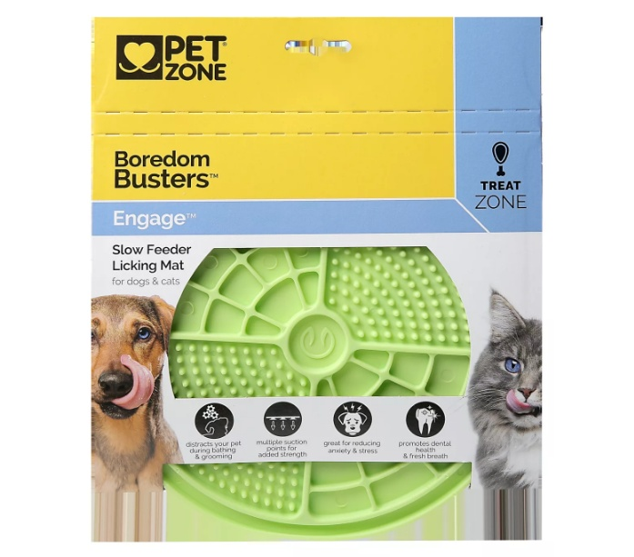
PET BOWLS
Item Number
5303389
Color
Green
Retail
$12.99
Country
-
DESCRIPTION
Pet Zone Boredom Busters™ Engage Slow Feeder Licking Mat
MATERIAL
DIMENSIONS & SPECIFICATIONS
High quality, non-toxic FDA Grade TPE
8 x 8 x .25

Slide 38
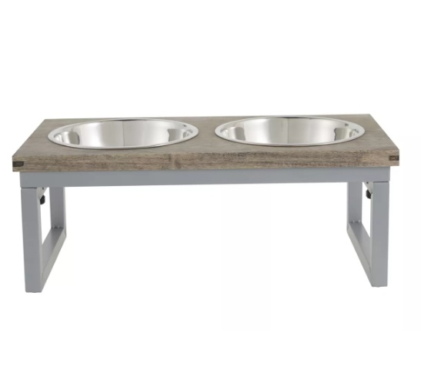
PET BOWLS
Item Number
5302393
Color
Grey, Silver
Retail
$39.99
Country
-
DESCRIPTION
Top Paw® Grey Wood Top Folding Legs Elevated Dog Feeder, 3.5-cup
MATERIAL
DIMENSIONS & SPECIFICATIONS
Wood. Stainless Steel
Stand: 16.31 in L x 8.5 in W x 6.31 in H (41.4 x 21.59 x 16.03 cm)

